Slide 1


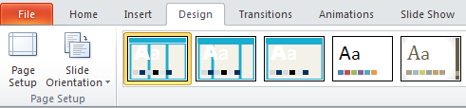
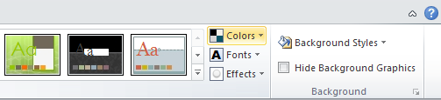
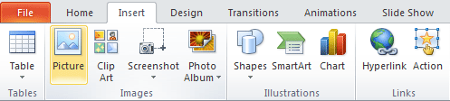
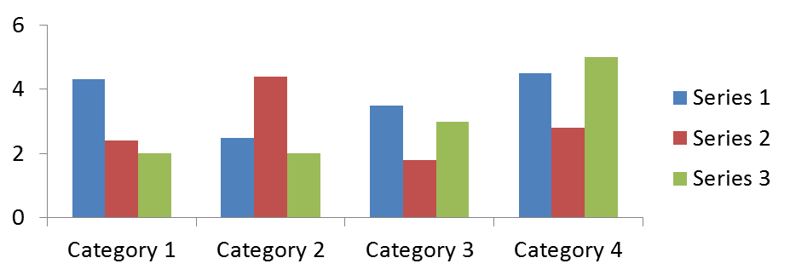



PAPER TITLE (TEMPLATE FOR A 841MM X 594MM POSTER PRESENTATION)
The names of the authors
The affiliation names go here
Serbian Tribology
Society
Faculty of Engineering
University of Kragujevac
19th International International Conference on Tribology - SERBIATRIB ’25
Kragujevac, Serbia, 14 – 16 May 2025
Poster Basics Sections (ex: “1- INTRODUCTION”)
Poster Basics Sections (ex: “4- MATERIALS”)
Poster Basics Sections (ex: “ACKNOWLEDGEMENT”)
This template was designed to produce a 841mm x 594mm (A1 size) poster portrait mode. You can modify it as needed for your presentation before you send it to printer.
Making use of this template will ensure that your poster will look professional, easy to read and save you valuable time in the layout of your presentation.
For poster design beginners we have included many useful tips you can find on the poster template itself.
Depending on your content and how you wish to layout your poster, you may want to change the column layout of your poster. This can be achieved quite simply by selecting one of the three master themes we have included. To select a different layout go to the DESIGN tab (see figure 1). Then you can easily select an different column layout from the options available.
Importing tables, charts and graphs is easier than importing photos. To import charts and graphs from Excel, Word or other applications, select EDIT>COPY, to copy your chart.
Come back to PowerPoint and select EDIT>PASTE and paste the chart on the poster. You can scale your charts and tables proportionally by holding down the Shift key and dragging in or out one of the corners.
Charts may be imported using an alternative procedure. To import charts and graphs from Excel, Word or other applications, select EDIT>COPY, to copy your chart.
Come back to PowerPoint and select EDIT>PASTE SPECIAL and paste the chart on the poster as image file (PNG, TIFF, JPEG, ETC.).
Figure 1 – Alternative design solutions.
Table 1 - Simple column table.
Poster Basics Sections (ex: “5- RESULTS”)
TABLE SAMPLE
2010 | 2011 | 2012
2013 | 2014 | 2015
2016 | 2017 | 2018
If you wish to modify further your poster presentation, selecting a preset color scheme from the colours option under the DESIGN tab. If you would like to change the default colors use DESIGN tab (Figure 2). Then click on the COLORS drop-down menu on the right (Figure 3).
Poster Basics Sections (ex: “2- OBJECTIVES”)
Figure 2 – Alternative design solution .
After you decide how many sections you need for your poster (INTRODUCTION, OBJECTIVES, METHODS, MATERIALS, RESULTS, CONCLUSIONS, REFERENCES, ACKNOWLEDGEMENT, etc.), use the “copy” and “paste” commands to create as many copies of the black section headers as needed.
Move the header copies to where you think they need to be on the poster, so you can get a better idea of the overall poster layout. This will help you organize your content.
You can now start adding your text.
To add text use the text tool to draw a text box starting from the left edge of a column to the right edge and start typing in your text. You can also paste the text you may have already copied from another source.
Repeat the process throughout the poster as needed.
Figure 3 - Alternative color solutions.
Poster Basics Sections (ex: “6- CONCLUSIONS”)
It is highly recommended to use the largest images you have access to for your poster. Avoid copying and pasting images instead of using the “Insert” command. To insert an image to your poster go to the INSERT tab and then click on PICTURE (Figure 4).
Figure 6 - Insert images with editable conditions.
Figure 4 - Insert images.
Scaling an image must be applied with caution. Scaling more than three times its original size may introduce pixilation artifacts. Refer to Figure 5 as an example.
A simple way to preview the printing quality of an image is to zoom in at 100% or 200%, depending on the final size of the poster. What you will see is likely what you will get after printing.
Poster Basics Sections (ex: “3- METHODS”)
For this poster template the Arial font family is used at several recommended text sizes. You can use any different font you like and at any size but try to stay close to the suggested limits.
Figure 5: Original image at 100%, enlarged to 200% and 400%.
Figure 7 - Insert images.
Poster Basics Sections (ex: “REFERENCES”)
CONTACT INFORMATION
The blue header bars are used to identify and separate the main topics of your presentation. The most commonly used headers in poster presentations are:
INTRODUCTION, OBJECTIVES, METHODS, MATERIALS, RESULTS, CONCLUSIONS, REFERENCES, ACKNOWLEDGEMENT, CONTACT INFORMATION, ETC.
Details on your contact information may be provided.
19th International International Conference on Tribology - SERBIATRIB ’25
Kragujevac, Serbia, 14 – 16 May 2025

